Slide 1
Intrusion Detection System
(Snort & Barnyard)
60-564: Security and Privacy on the Internet
Instructor: Dr. A. K. Aggarwal
Presented By: Vic Ho & Kashif Saeed
Date: March 20, 2006

Slide 2
Table of Contents
Introduction
System Architecture & Data Flow
Software Component
  3.1. Packet Excalibur
  3.2. Snort
  3.3. Barnyard
  3.4. MySQL Server
Acknowledgement
Reference

Slide 3
1. Introduction
Intrusion: a series of unauthorized actions that attempt to compromise the confidentiality, integrity or availability of the resources [1].
Intrusion Detection System: is used to detect this kind of actions in order to warn the administrator so that further prevention can be done.

Slide 4
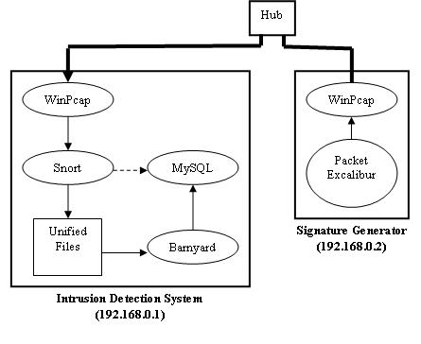
2. System Architecture & Data Flow

Slide 5
3. Software Component
3.1. Packet Excalibur
3.2. Snort
3.3. Barnyard
3.4. MySQL Server

Slide 6
3.1. Packet Excalibur
A multi-platform graphical and scriptable network packet engine which has extensible text based protocol descriptions [2].
Used to built and customize packets in order to match the signatures.

Slide 7
3.1. Packet Excalibur
Packet Generation:
Configure Data Link Type
Configure Ethernet Layer
Configure IP Layer
Configure TCP Layer
Configure Data

Slide 8
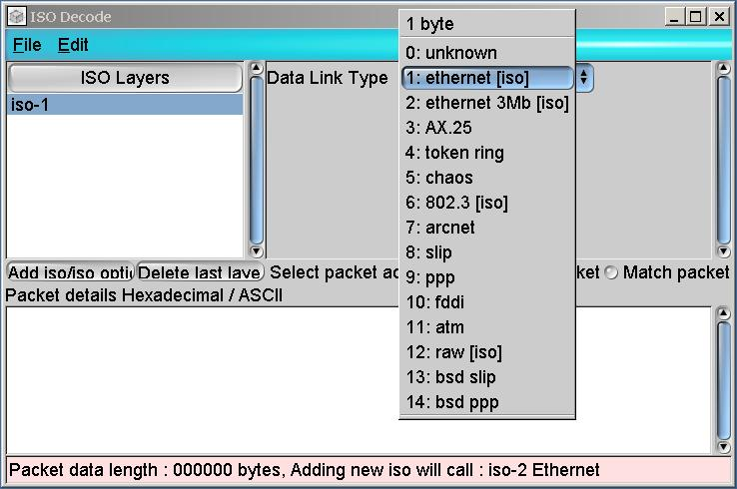
3.1. Packet Excalibur
1. Configure Data Link Type
  Select 1: ethernet [iso]

Slide 9
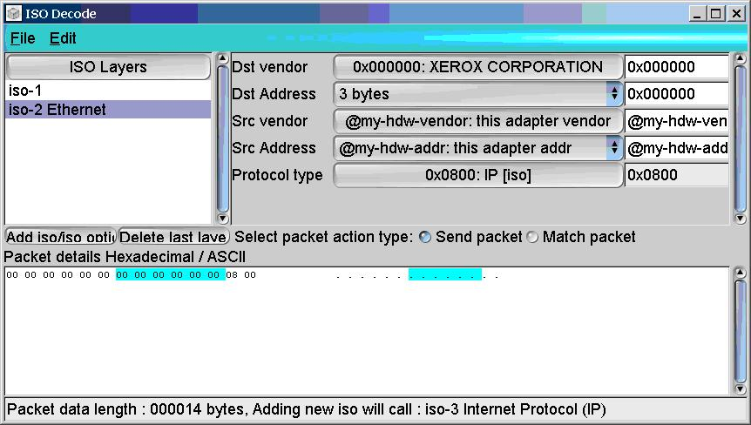
3.1. Packet Excalibur
2. Configure Ethernet Layer
  Set the value of Src vender
  Set the value of Src Address
  Set the value of Protocol type

Slide 10
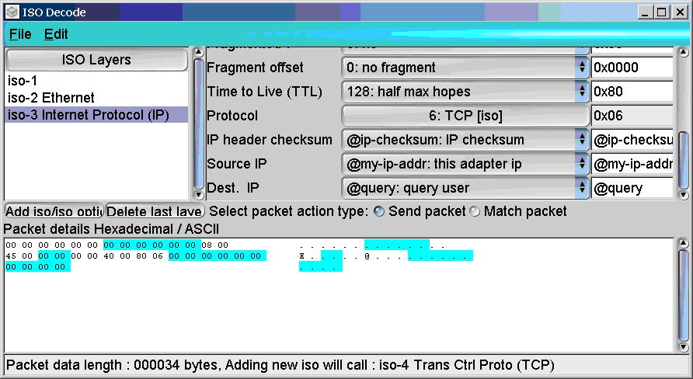
3.1. Packet Excalibur
3. Configure IP Layer
  Set the value of Protocol
  Set the value of Source IP
  Set the value of Dest. IP

Slide 11
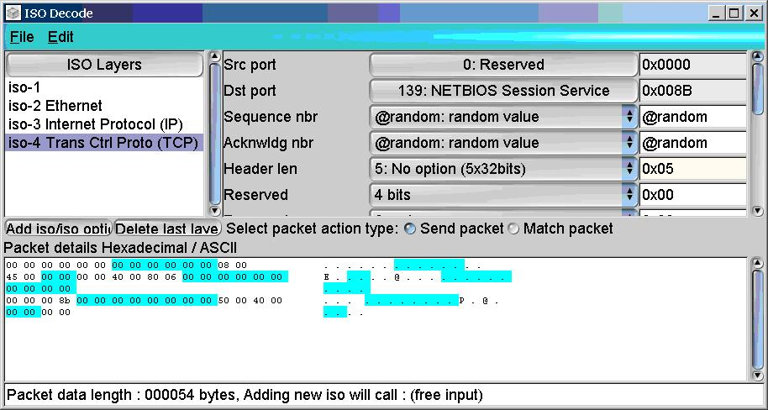
3.1. Packet Excalibur
4. Configure TCP Layer
  Set the value of Dst Port
  Set the value of Sequence nbr
  Set the value of Acknwldg nbr

Slide 12
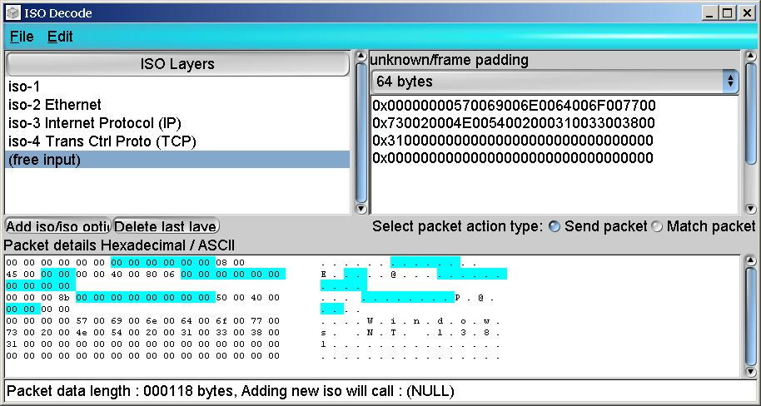
3.1. Packet Excalibur
5. Configure Data
  Set the number of bytes to add
  Input the data according to the contents of the snort rules

Slide 13
3.2. SNORT
Snort is Open Source, covered under the GPL
  Developed by Martin Roesch
  Rules-based detection engine
  Plug-in system allows endless flexibility
  Rules are readily editable and freely available
  Performs Real-time traffic analysis, logging, and alerting
  Sourcefire offers commercial version of Snort (Sourcefire Intrusion Sensor)

Slide 14
Snort – Basic Configuration Modes
Snort can be run in one of several configuration modes
  Sniffer Mode – Snort reads packets off of the network and displays them on console
  Packet Logger Mode – simply logs packets to disk
  Network Intrusion Detection System (NIDS) mode – Snort grabs traffic from the network using Winpcap, analyzes for matches to a defined rule set and generates alerts (as appropriate)

Slide 15
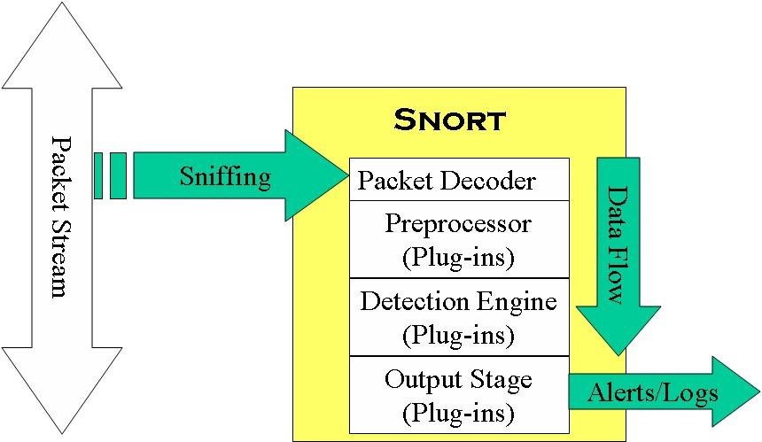
Snort Data Flow

Slide 16
Packet Decoder
  Libpcap,External Packet Capture Library (UNIX, Windows ports (winpcap))
  Captures raw packets (required for Snort processing)
  Series of Packet Decoders decode specific protocol elements of each packet
  As packets are decoded, decoded packet data is stored in a Snort data structure for analysis

Slide 17
Plug-Ins
Preprocessor
  Packets are examined/manipulated before being handed to the detection engine
Detection
  Perform single, simple tests on a single aspect/field of the packet
Output
  Report results from the other plug-ins

Slide 18
Preprocessors
Examine suspicious packets
Manipulate packets to prepare for detection engine
Packets are passed through every Preprocessor for thorough packet inspection process

Slide 19
Detection Engine
Performs several functions
  Rule Parsing – rules are loaded into internal data structures, and guide packet inspection
  Signature Detection – attack signatures are constructed by parsing Snort rules
Other possibilities
  Snort + Netfilter (or Divert Sockets) = Gateway IDS (or “packet scrubber”)
  Snort + NMAP = Target-based IDS

Slide 20
Output plug-in
  Database (MySQL, PostgreSQL, Oracle, unixODBC, etc)
  XML
  Unified (Snort specific) format
  ASCII, syslog, WinPopup (SMB)
  Etc

Slide 21
Running Snort
To run snort go to your snort bin directory. In our case it was C:\Snort\bin. Once there you can run snort by combining appropriate options with snort
USAGE:
snort [-options] <filter options>
e.g.
Running in SNIFFER MODE
Snort –v -i<interface> or Snort –vd
Running in PACKET LOGGER MODE
Snort –dev –l C:\snort\log -i<interface> (C:\snort\log is the log directory location in our experiment)

Slide 22
Running Snort
Running in NETWORK INTRUSTION DETECTION MODE
Snort –dev –l C:\snort\log –c C:\snort\etc\snort.conf -i<interface> (C:\snort\etc\snort.conf is the location for snort.conf file in our experiment)
COMMAND we used for running snort in our project was
Snort –dev –l C:\snort\log –c C:\snort\etc\snort.conf -i<interface>

Slide 23
3.3. Barnyard
An add-on tool for Snort
Barnyard allows logging/alerting operations to be offloaded from Snort
Uses data generated by the Snort Unified output plug-in (Barnyard is a Unified Log Reader)

Slide 24
Barnyard
Barnyard allows logging/alerting operations to be offloaded from Snort
Improves the performance of Snort
  Unified output logging is comparatively fast
  Offloads performance-intensive logging operations from Snort (e.g. database logging)
  This frees Snort to focus on packet inspection
Critical for large volume, high bandwidth environments (e.g. 1000Mbps)

Slide 25
Snort Configuration
Unified: Snort unified binary format alerting and logging
The unified output plug-in provides new format for logging and generating alerts from Snort, the "unified" format
Reduces the overhead for logging and alerting to slow storage mechanisms. E.g Databases.

Slide 26
Snort Configuration
Unified OUTPUT PLUG-IN
  output alert_unified: snort.alert, limit 128
  output log_unified: snort.log , limit 128
    Limit: Maximum size of spool file in MB (default: 128)
    Snort.alert and snort.log are base filenames to write to, they are appended with current time.
    E.g
      snort-unified.alert.1142355067
      snort-unified.log.1142355067

Slide 27
Barnyard Configuration
Modify barnyard.conf to turn on/off data processors and output plugins
Where to find the config file ?
  $Barnyard_HOME\etc
Data processors (dp’s)
  Two types of data processors
    Alert
    Log

Slide 28
Barnyard Configuration
Data processor for ALERTs
  dp_alert
    The dp_alert data processor is capable of reading the alert (event) format generated by Snort's spo_unified plug-in.
    Used with output plug-ins that support the "alert" input type.
    This plug-in takes no arguments.
      processor dp_alert

Slide 29
Barnyard Configuration
Data processor for LOGs
  dp_log
    Capable of reading the log format generated by Snort's spo_unified plug-in.
    Used with output plug-ins that support the "log" input type
    This plug-in takes no arguments
      processor dp_log

Slide 30
Barnyard Configuration
Output Plugin
  alert_fast
    Converts data from the dp_alert plugin into an approximation of Snort's "fast alert" mode.
      “output alert_fast”
  log_dump
    Converts data from the dp_log plugin into an approximation of Snort's "ASCII packet dump" mode
      “output log_dump”
  alert_html
    Creates a series of html pages about recent alerts
      “output alert_html”

Slide 31
Barnyard Configuration
  alert_csv
    Creates a CSV output file of alerts
    “output alert_csv: csv.out”
    Fields available to this plugin are
    Timestamp
    Msg
    Srcip
    Sport
    Dstip
    Etc, all fields are comma separated with no space in between

Slide 32
Barnyard Configuration
  acid_db ( Used in the project )
    Available as both a log and alert output plug-in.
    Used to output data into the db schema
    output alert_acid_db: mysql, sensor_id 1, database snort, server localhost, user snortusr
    output log_acid_db: mysql, sensor_id 1, database snort, server localhost, user snortusr

Slide 33
Running Barnyard
Three modes of operations
One-Shot
  Barnyard will process the specified file and exits
Continual
  Barnyard will start with the specified file and continue to process new data (and new spool files) as it appears
Continual w/ checkpoint
  Uses a checkpoint file to track where it is.

Slide 34
Running Barnyard
Command to run
> barnyard –c $Barnyard_HOME\etc\barnyard.conf –d $SNORT_HOME\log snort-unified.alert
-c Specifies where the barnyard configuration file is
-d Specifies where the Spool file directory is
-f Sets the base spool file name

Slide 35
3.4. MySQL Database
Project uses MySQL database for logging and alerting
Database schema is provided by the snort installation documentation.
Schema scripts located in
  $SNORT_HOME\schemas
  Snapshot

Slide 36
Database Configuration
A root user is created with standard mysql database installation.
Login with root and run the script to create snort schema
Mysql > SOURCE $SNORT_HOME\Schemas\create_mysql
Next create a user for barnyard to access this database
mysql >Create user snortusr;
Grant access and modification rights to this user.
mysql > grant INSERT,SELECT on snort.* to snortusr@localhost;
  mysql > grant INSERT,SELECT,UPDATE on snort.sensor to
  snortusr@localhost;

Slide 37
4. Acknowledgement
We would like to thank group 3 (Tarik El Amsy & Lihua Duan) who helped in better understanding of snort rules in respect to packet generation.

Slide 38
5. Reference
[1] “Intrusion Detection.” Wikipedia, the free encyclopedia. 7 Mar. 2006 <http://en.wikipedia.org/wiki/Intrusion_Detection>.
[2] “Packet Excalibur.” Security Bugware. 7 Mar. 2006 <http://www.securitybugware.org/excalibur/>.
[3] “WinIDS Installation Guide.” WinSnort.com. 7 Mar. 2006 <http://www.winsnort.com/modules.php?op=modload&name=Sections&file=index&req=viewarticle&artid=5&page=1>.
[4] “WinPcap: The Windows Packet Capture Library.” Winpcap.org. <http://www.winpcap.org/>.
[5] MySQL. < http://www.mysql.com/>.
[6] Snort.org. <http://www.snort.org/>.

